Slide 1
The Command Pattern
Presented by - Md Farhan Ishmam
Student ID - 180041120

Slide 2
Table of contents
01
02
03
04
05
06
Definition
Example Problem & Solution
Structure & Components
Sequence Diagram
Benefits
Queueing & Logging Requests

Slide 3
What is the command pattern?
Encapsulates a request as an object and lets us parameterize other objects with different requests, queue or log requests, and support undoable operations
Notes:
No need to explain the definition briefly

Slide 4
Cracking the definition
The definition might be too complicated to understand but we can decipher it by breaking it down into smaller parts and asking these simple questions:
What do you mean by encapsulating a request as an object? Encapsulating, simply, means containing or packaging. Usually, the request is just a method or function. But in command pattern, the request will be represented as an object and all the necessary information of the request shall be contained within the object. There will be an execute() method within the object to fulfill the request.
Notes:
The easiest way to understand a complex definition is to break it down into smaller parts and ask simpler questions. Keep asking questions until the elements of the definition breaks down into a form so simple that anyone can understand.

Slide 5
Cracking the definition
What do we mean by parameterize other objects with different requests? Remember the “information” encapsulated in object from the last question? That information includes method name, the object that owns the method, and the parameter values. But what are parameter values? They are simply, the input values passed to method. When a different request is made, we pass a different object as the input (i.e as parameter) and thus, fulfil the request.
Okay! But what are the queues and log requests? We will see that later in the presentation.
Notes:
Let’s just keep these concepts in mind and look through an example problem

Slide 6
But why do we need Command Pattern?
Problem: What if we want to design a menu toolkit in the UI which carries requests in response to user input but can’t carry the request explicitly in the menu buttons? The toolkit designer won’t be able to know the receiver of the request or the operations to be done. Is there any way to issue requests without knowing the operation and receiver of the request?

Slide 7
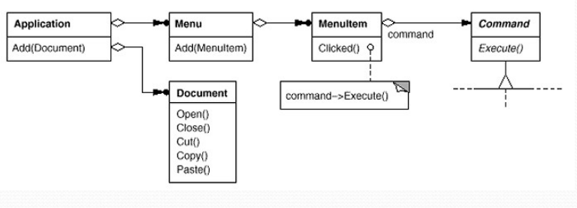
The Solution

Slide 8
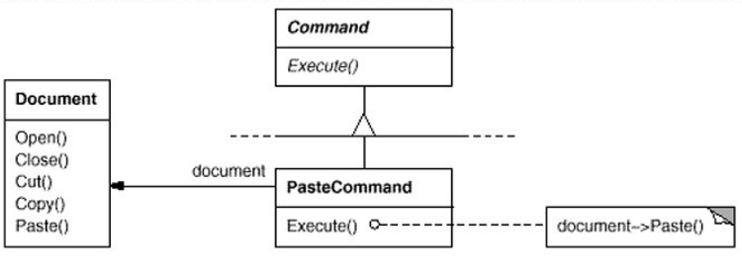
The Solution (continued)

Slide 9
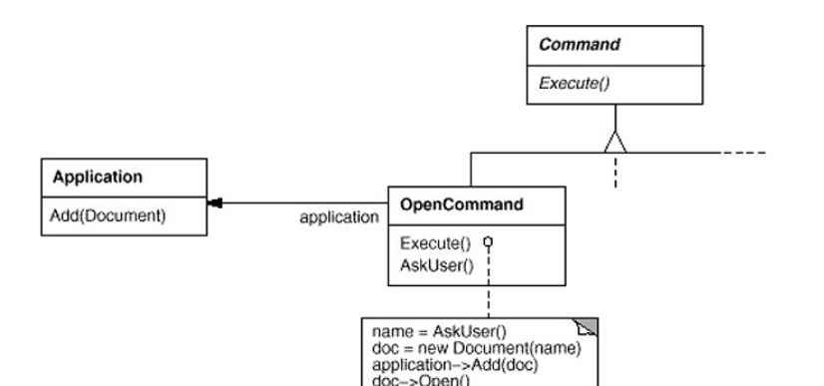
The Solution (continued)
Can you spot the use of command pattern?
Notes:
Ask them if they can spot the use of command pattern in the solution?

Slide 10
Key Takeaways
Toolkit objects make requests of unspecified application objects by turning the request itself into an object
An abstract Command class acts as an interface for executing operations and includes an abstract Execute operation
Concrete Command subclasses specify a receiver-action pair by storing the receiver as an instance variable and by implementing Execute to invoke the request
The receiver has the knowledge required to carry out the request
Notes:
Try to make the audience relate the definition with the given example. Revisit the definition to make them relate to the key takeaways from the solution.

Slide 11
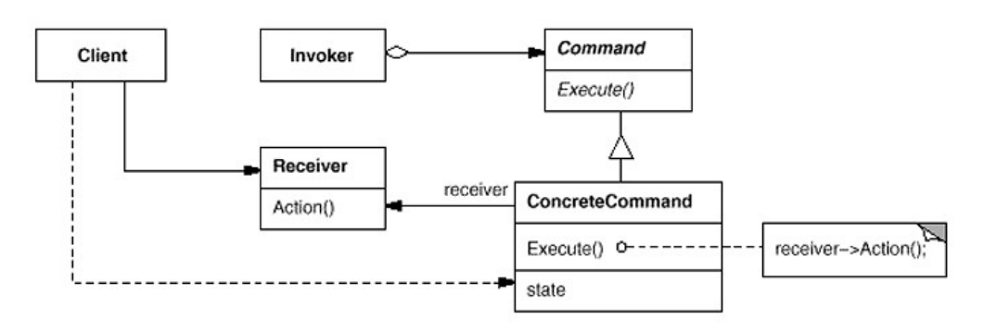
The Basic Structure
Notes:
Don’t go into details while explaining the structure. Just a quick overview of the components and their relationships. Ensure your audience that they don’t need to keep the whole structure in their head and you will go through the components shortly after.

Slide 12
The Components
Command
An interface for executing an operation
ConcreteCommand
A binding between a Receiver object and an action
Implements Execute by invoking the corresponding operation(s) on Receiver
Client
Creates a ConcreteCommand object and sets its receiver

Slide 13
The Components
Invoker
Asks the command to carry out the request
Receiver
Knows how to perform the operations associated with carrying out a request

Slide 14
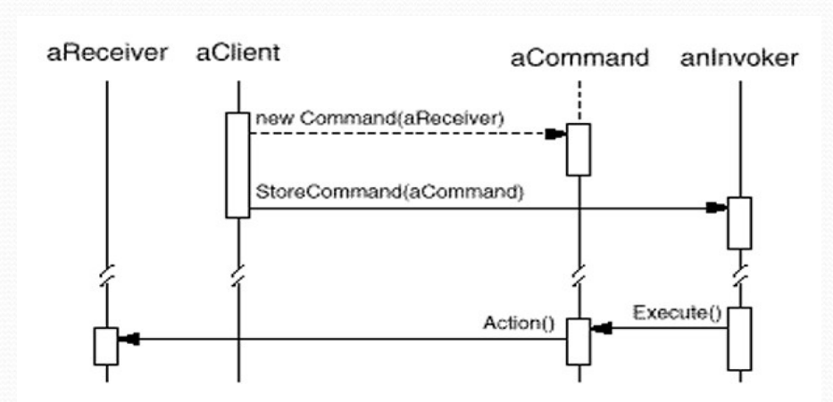
The Sequence Diagram
Notes:
A better way to understand the components and their interactions is to look at the elements using the sequence diagram.

Slide 15
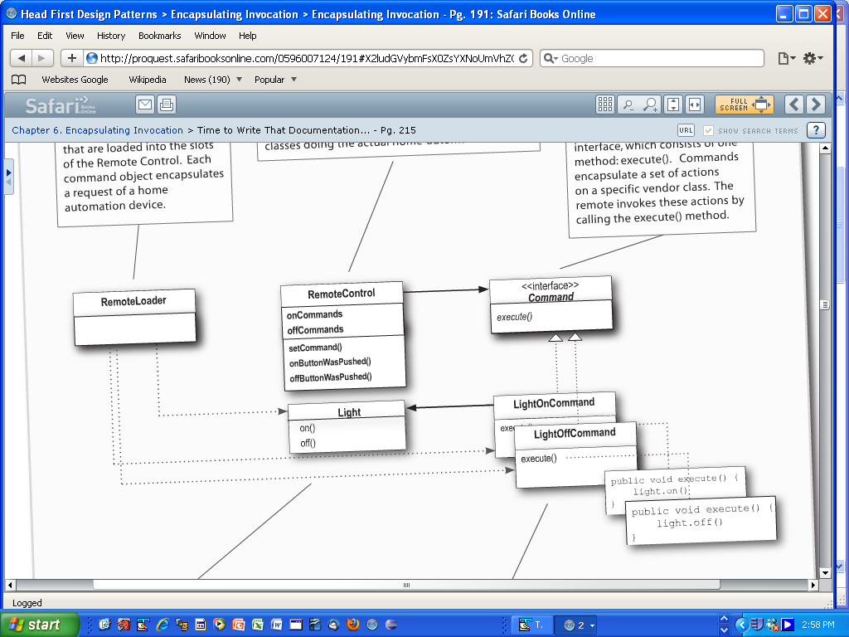
Another Example
Notes:
Make sure that the audience can relate the basic structure with the example

Slide 16
The Benefits?
Command decouples the object that invokes the operation from the one that knows how to perform it
Commands can be manipulated and extended like any other object
We can assemble commands into a composite command
Easier to add new Commands, because we don't have to change existing classes

Slide 17
What are the queueing and logging requests?
Queuing Requests Can allocate commands to various threads for processing to load balance between threads and processors
Logging Requests Save the command object as they execute. If something goes wrong, the log can be read and the sequence of commands can be recreated.
Notes:
We go back to the question we asked while cracking the definition

Slide 18
Thanks
Notes:
Feel free to ask questions

